Slide 1
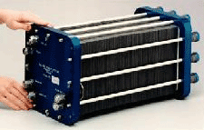
Fuel Cells

Slide 2
The Promise of Fuel Cells
“A score of nonutility companies are well advanced toward developing a powerful chemical fuel cell, which could sit in some hidden closet of every home silently ticking off electric power.”
Theodore Levitt, “Marketing Myopia,” Harvard Business Review, 1960
Theodore Levitt, “Marketing Myopia,” Harvard Business Review, 1960

Slide 3
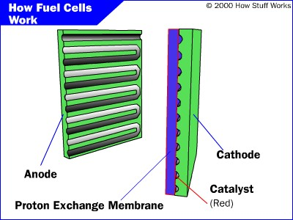
PEM Fuel Cell

Slide 4
Parts of a Fuel Cell
Anode
Negative post of the fuel cell.
Conducts the electrons that are freed from the hydrogen molecules so that they can be used in an external circuit.
Etched channels disperse hydrogen gas over the surface of catalyst.
Cathode
Positive post of the fuel cell
Etched channels distribute oxygen to the surface of the catalyst.
Conducts electrons back from the external circuit to the catalyst
Recombine with the hydrogen ions and oxygen to form water.
Electrolyte
Proton exchange membrane.
Specially treated material, only conducts positively charged ions.
Membrane blocks electrons.
Catalyst
Special material that facilitates reaction of oxygen and hydrogen
Usually platinum powder very thinly coated onto carbon paper or cloth.
Rough & porous maximizes surface area exposed to hydrogen or oxygen
The platinum-coated side of the catalyst faces the PEM.

Slide 5
Fuel Cell Operation
Pressurized hydrogen gas (H₂) enters cell on anode side.
Gas is forced through catalyst by pressure.
When H₂ molecule comes contacts platinum catalyst, it splits into two H+ ions and two electrons (e-).
Electrons are conducted through the anode
Make their way through the external circuit (doing useful work such as turning a motor) and return to the cathode side of the fuel cell.
On the cathode side, oxygen gas (O₂) is forced through the catalyst
Forms two oxygen atoms, each with a strong negative charge.
Negative charge attracts the two H+ ions through the membrane,
Combine with an oxygen atom and two electrons from the external circuit to form a water molecule (H₂O).

Slide 6
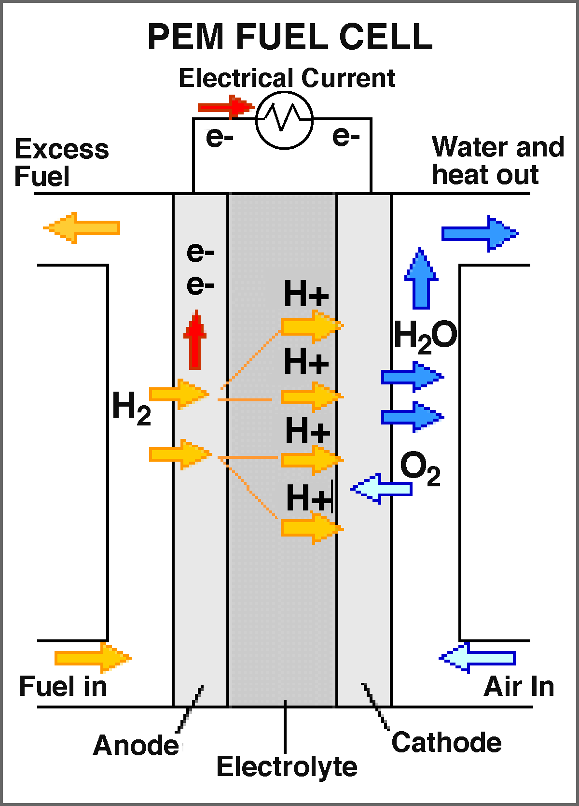
Proton-Exchange Membrane Cell
http://www.news.cornell.edu/releases/Nov03/Fuelcell.institute.deb.html
Notes:
How a fuel cell works: In the polymer electrolyte membrane (PEM) fuel cell, also known as a proton-exchange membrane cell, a catalyst in the anode separates hydrogen atoms into protons and electrons. The membrane in the center transports the protons to the cathode, leaving the electrons behind. The electrons flow through a circuit to the cathode, forming an electric current to do useful work. In the cathode, another catalyst helps the electrons, hydrogen nuclei and oxygen from the air recombine. When the input is pure hydrogen, the exhaust consists of water vapor. In fuel cells using hydrocarbon fuels the exhaust is water and carbon dioxide. Cornell's new research is aimed at finding lighter, cheaper and more efficient materials for the catalysts and membranes.

Slide 7
PEM Fuel Cell Animation
Click on Diagram

Slide 8
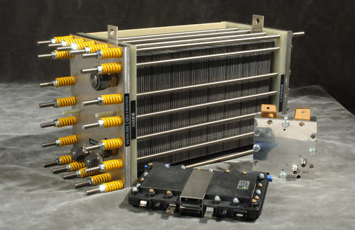
Fuel Cell Stack
http://www.nrel.gov/hydrogen/photos.html
Notes:
Tomorrow, hydrogen's use as a fuel for fuel cells will grow dramatically-for transportation, stationary and portable applications. (PlugPower 5-kW fuel cell (large cell), H2ECOnomy 25-W fuel cell (small silver cell), and Avista Labs 30-W fuel cell).

Slide 9
Hydrogen Fuel Cell Efficiency
40% efficiency converting methanol to hydrogen in reformer
80% of hydrogen energy content converted to electrical energy
80% efficiency for inverter/motor
Converts electrical to mechanical energy
Overall efficiency of 24-32%

Slide 10
Auto Power Efficiency Comparison
Technology | System Efficiency
Fuel Cell | 24-32%
Electric Battery | 26%
Gasoline Engine | 20%
http://www.howstuffworks.com/fuel-cell.htm/printable
Notes:
Maybe you are surprised by how close these three technologies are. This exercise points out the importance of considering the whole system, not just the car. We could even go a step further and ask what the efficiency of producing gasoline, methanol or coal is.
Efficiency is not the only consideration, however. People will not drive a car just because it is the most efficient if it makes them change their behavior. They are concerned about many other issues as well. They want to know:
Is the car quick and easy to refuel?
Can it travel a good distance before refueling?
Is it as fast as the other cars on the road?
How much pollution does it produce?
This list, of course, goes on and on. In the end, the technology that dominates will be a compromise between efficiency and practicality.

Slide 11
Other Types of Fuel Cells
Alkaline fuel cell (AFC)
This is one of the oldest designs. It has been used in the U.S. space program since the 1960s. The AFC is very susceptible to contamination, so it requires pure hydrogen and oxygen. It is also very expensive, so this type of fuel cell is unlikely to be commercialized.
Phosphoric-acid fuel cell (PAFC)
The phosphoric-acid fuel cell has potential for use in small stationary power-generation systems. It operates at a higher temperature than PEM fuel cells, so it has a longer warm-up time. This makes it unsuitable for use in cars.
Solid oxide fuel cell (SOFC)
These fuel cells are best suited for large-scale stationary power generators that could provide electricity for factories or towns. This type of fuel cell operates at very high temperatures (around 1,832 F, 1,000 C). This high temperature makes reliability a problem, but it also has an advantage: The steam produced by the fuel cell can be channeled into turbines to generate more electricity. This improves the overall efficiency of the system.
Molten carbonate fuel cell (MCFC)
These fuel cells are also best suited for large stationary power generators. They operate at 1,112 F (600 C), so they also generate steam that can be used to generate more power. They have a lower operating temperature than the SOFC, which means they don't need such exotic materials. This makes the design a little less expensive.
http://www.howstuffworks.com/fuel-cell.htm/printable

Slide 12
Advantages/Disadvantages of Fuel Cells
Advantages
Water is the only discharge (pure H₂)
Disadvantages
CO₂ discharged with methanol reform
Little more efficient than alternatives
Technology currently expensive
Many design issues still in progress
Hydrogen often created using “dirty” energy (e.g., coal)
Pure hydrogen is difficult to handle
Refilling stations, storage tanks, …

Slide 13
Fuel Cells

Slide 14
Extra Slides

Slide 15
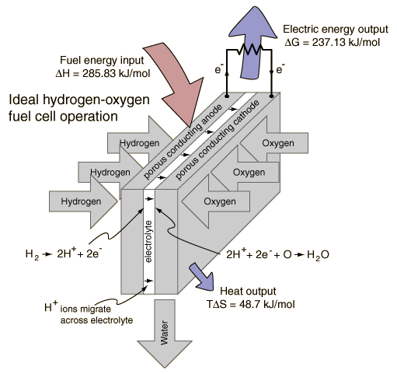
Fuel Cell Energy Exchange
http://hyperphysics.phy-astr.gsu.edu/hbase/thermo/electrol.html
Notes:
Hydrogen and oxygen can be combined in a fuel cell to produce electrical energy. A fuel cell uses a chemical reaction to provide an external voltage, as does a battery, but differs from a battery in that the fuel is continually supplied in the form of hydrogen and oxygen gas. It can produce electrical energy at a higher efficiency than just burning the hydrogen to produce heat to drive a generator because it is not subject to the thermal bottleneck from the second law of thermodynamics. It's only product is water, so it is pollution-free. All these features have led to periodic great excitement about its potential, but we are still in the process of developing that potential as a pollution-free, efficient energy source (see Kartha and Grimes).

Slide 16
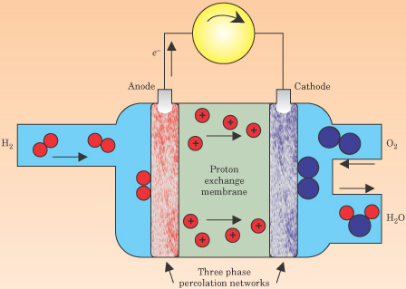
PEM Fuel Cell Schematic
Notes:
Figure 5. In a proton−exchange−membrane fuel cell, hydrogen and oxygen react electrochemically. At the anode, hydrogen molecules dissociate, the atoms are ionized, and electrons are directed to an external circuit; protons are handed off to the ion−exchange membrane and pass through to the cathode. There, oxygen combines with protons from the ion−exchange membrane and electrons from the external circuit to form water or steam. The energy conversion efficiency of the process can be 60% or higher.

